Slide 1
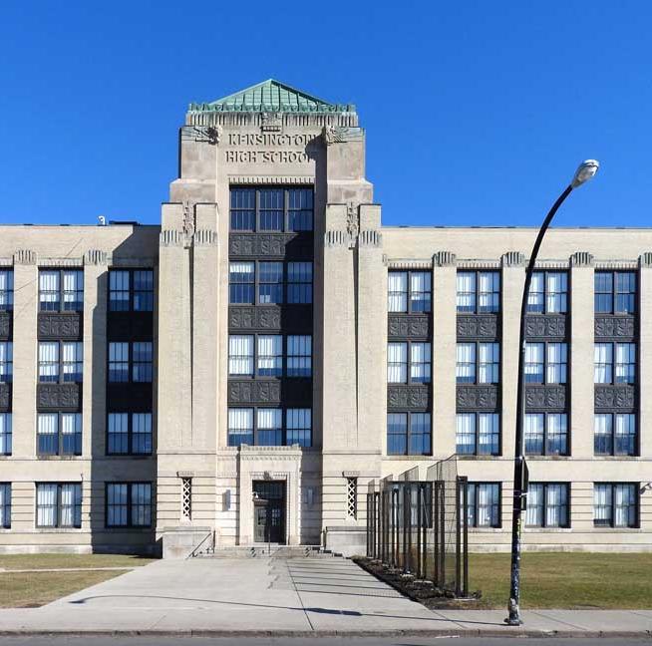
Re-Opening Parent Forum
January 14, 2021

Slide 2
Agenda
Review of Re-Opening Plan
Re-Opening Timeline
BPS District Guidance
Olmsted Protocols
Health & Safety Protocols
Sanitation & Cleaning Protocols
Arrival & Dismissal Procedures
Modified Daily Routines & Procedures
Classroom Set-Up & Instructional Modes
COVID-19 Testing
Transportation

Slide 3
FLO Re-Opening Plan
Phase 1: February 1st
FOCUS: Grade 12
Career & College Readiness Transition Plan
Tutoring
A. P. and Regents Exam Preparation
College Support: essays, applications, scholarships
Transition Plans: college vs. careers
Mentoring
Complete plan available: FLO #156 Reopening Plan

Slide 4
Re-Opening Timeline
Phase 1: February 1st
Other phases will be included at intervals to be determined by BPS. Once determined, SBMT will decide which grade levels will be returning using the same data used to determine Phase 1:
Attendance
Academics
Attitude (Referrals)

Slide 5
BPS District Guidance: COVID-19 Testing
BPS will be sending communication regarding the required 20% random testing to occur monthly throughout the District.
What we know so far...
Students will be chosen randomly by the District for testing. Parents will be notified by the District of the date their child will be tested (24-hour window).
Parents will be able to choose whether to test their child in school or at an alternate site (72-hours within given date). You may also opt-out using the consent form that will be mailed to students who will be attending in-person.
If choosing an alternate site, testing must be completed by the specified date. Results must be provided to the School Nurse.
If choosing to test in school, the School Nurse will conduct the test. Positive results will be communicated to parents and the Principal.
If a child tests positive, they will need to be picked up IMMEDIATELY by someone with permission as per Infinite Campus.
If a child cannot be picked up, an ambulance will be dispatched. The parent will have to meet school personnel at the hospital.
Contact tracing will take place under the guidance of the Erie County Department of Health and BPS.

Slide 6
BPS District Guidance: Transportation
If choosing BPS transportation, MS students will continue with yellow busing and HS students will continue with NFTA transportation, unless indicated on their IEP.
Maximum on the Metro, 24 persons. If the bus is at max, it will keep going.
The Transporation Department has assured parents all safety precautions and social distancing will be observed on buses. These were communicated in a letter sent over Winter Break.

Slide 7
Olmsted Protocols: Health & Safety
To maintain a safe and orderly environment at Olmsted 156:
All faculty, staff, and students will complete a health screening survey prior to entering the building.
Forms will be available online and paper copies will be available at the entrances (staff and student).
No visitors will be allowed in the building at this time. We will continue with virtual meetings.
Everyone in the building must wear a mask and observe all social distancing protocols.
Signage is clearly posted throughout the building communicating all expectations.
** For students with MEDICAL REASONS that impede mask wearing, accommodations including the use of face shields will be provided per the District.
ENTRY & DEPARTURE TIMES
 | Entry Time | Departure Time
Staff | 7:30 a.m. | 3:30 p.m.
Students | 7:50 a.m. | 2:50 p.m.

Slide 8
Olmsted Protocols: Sanitation & Cleaning
CLEANING/DISINFECTING PROCEDURES:
Cleaning and disinfecting will be manually tracked and recorded through daily cleaning logs.
Arrival of Students -Clean and disinfect areas used by groups before the start of the school day.
During the School Day - Clean and disinfect high touch areas such as door handles, stair railings, elevator buttons, push bars, light switches etc. multiple times every day. All staff will support cleaning efforts.
Bathrooms will be monitored frequently and cleaned and disinfected frequently during the school day. Custodians will wipe down all sink hardware, toilets, door handles and other high touch areas. Restocking of soap dispensers and paper products, as necessary. Cleaning logs will be monitored.
Hospital grade disinfectant wipes will be available for all classrooms, in addition to spray bottle disinfectant and paper towels for wiping of desks and other surfaces.

Slide 9
Olmsted Protocols: Sanitation & Cleaning
AFTERSCHOOL CLEANING/DISINFECTING PROCEDURES:
Daily procedures for cleaning and disinfecting will be completed in all student and staff areas to prepare for the next day. Routine cleaning includes:
Clean all high touch items:
light switches, doorknobs, handrails, desktops, counters, handles, faucets, etc.
Dust mop and/or wet mop floors
Use of electrostatic sprayer

Slide 10
Olmsted Protocols: Arrival & Dismissal
All staff will enter through the parking lot door. All students will enter through the Main Entrance.
ARRIVAL
Students will have their temperature taken via thermal scanner.
Students will grab breakfast bags and go to HR.
HRs will be given times to send students to their lockers.
DISMISSAL
8th period classes will be assigned a dismissal time based on the number of students per floor.
Students will be dismissed to their lockers and then supervised as they exit the building.
Staff and Security personnel will supervise arrival and dismissal procedures.
Dismissal procedures will be coordinated using the PA system and announcements.

Slide 11
Modified Procedures for Late Arrival & Early Dismissal
Late Arrival:
Upon arrival, parent/guardian is to call the office.
Parent/Guardian is to wait outside of the building until Teacher/Aide/Assistant comes to the door.
Staff member will then take the student to the classroom.
Parent/guardian is to notify the Main Office for Early Pick-up by note, email, or phone call upon the student's arrival to the building.
When the parent/guardian arrives at school, he or she is to call the main office.
Main Office will contact the classroom and the student will be escorted to the Main Entrance.
Parent/Guardian will not be permitted to enter the building.
Sign-out will occur at the door.
Early Dismissal:

Slide 12
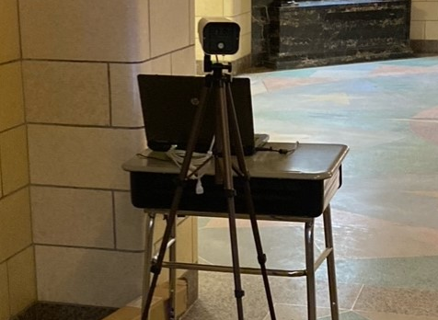
Thermal Scanner

Slide 13
Olmsted Protocols: Daily Routines & Procedures
BREAKFAST
LUNCH
Student breakfast will be served in classrooms during HR
Lunches will be served using a combination of grab and go (early release), cafeteria and classrooms (5th-6th grade)
Social distancing protocols will be followed
Spaces will be cleaned after students have finished eating
WATER
Water fountains will no longer be in use.
Students may use water bottles.
The water refilling station will be in use. Additional stations will be available. They will be sanitized throughout the day by maintenance staff.
** When using a classroom for food consumption, a window will remain open for ventilation.
All classroom doors will remain open throughout the day

Slide 14
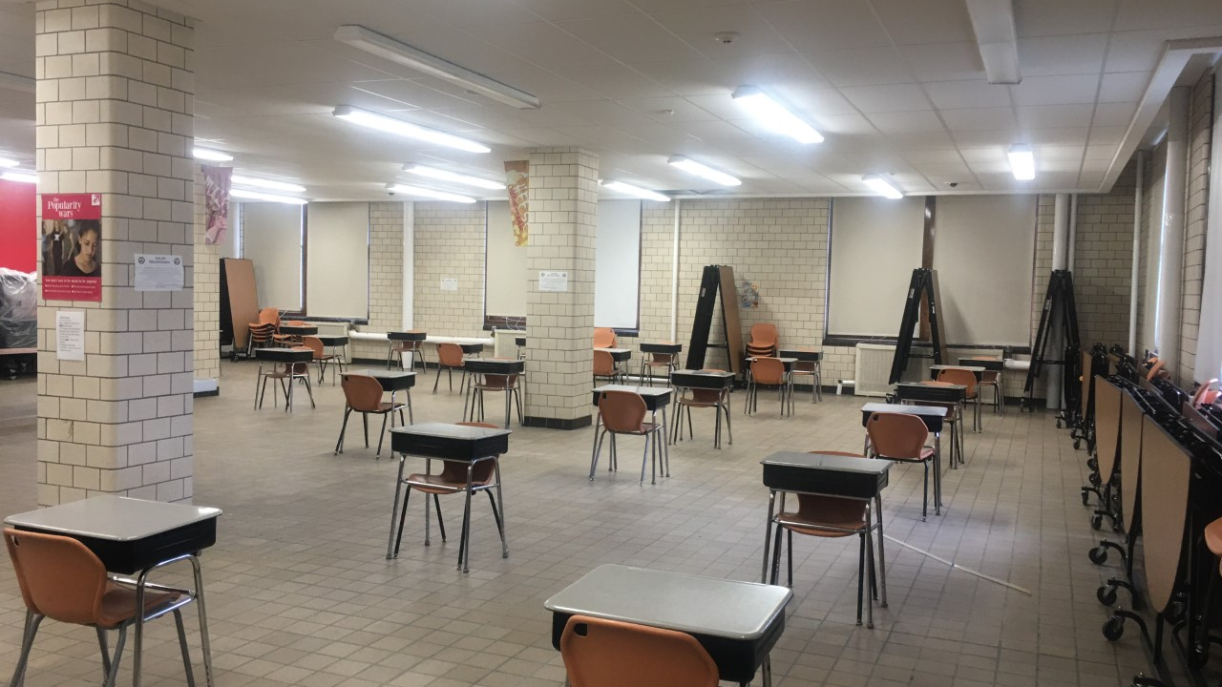
Cafeteria

Slide 15
Olmsted Protocols: Daily Routines & Procedures
CLASS TRANSITIONS
All students will walk on the right side of the hallway
Maintain social distancing 6 feet apart
Making sure masks are worn properly
Staff & Security personnel will be supervising all transitions
HALLWAYS/STAIRWELLS
No passes will be issued to other teacher's classrooms
Passes to Nurse/Guidance/Admin offices will be delivered to HR the morning of your appointment
Traffic patterns have been planned out and labeled throughout the building: up stairwells, down stair wells, staying to the right when in the hallways

Slide 16
Stairwells
Oakmont Stairs (209, 309, 409) will be used for going down
Auditorium Stairs will be used for going up
Hempstead Stairs (122, 221, 322, 422) will be used for going down
Cafeteria Stairs will be used for going up
Middle Stairs will only be used for arrival (going up) and dismissal (going down)

Slide 17
Hallways

Slide 18
Olmsted Protocols: Daily Routines & Procedures
If there is an emergency, students will be escorted by hall duty personnel to use the bathroom, one at a time, after the first 10 minutes of class and before the last 10 minutes of class to maximize instructional time
LOCKER USAGE
Students will be allowed to go to their lockers only three specified times: before first period, lunch, and dismissal
Each HR teacher and 8th period teacher will be given a specific time where their students may go to their lockers
Staff & Security personnel will be in the hallways supervising
BATHROOM USE
Bathroom use will be limited to transition times

Slide 19
Olmsted Protocols: Classroom Set-Up
Classrooms were set-up per Cannon Design social distancing protocols:
6 feet of social distancing + 2 feet of personal space
All areas have been accounted for and have a maximum capacity, which will be posted at the door.
Most classrooms are limited to 9 persons per room
Students must observe all social distancing protocols
"Safe spaces" have been identified for emergency situations (lockdown drills)

Slide 20
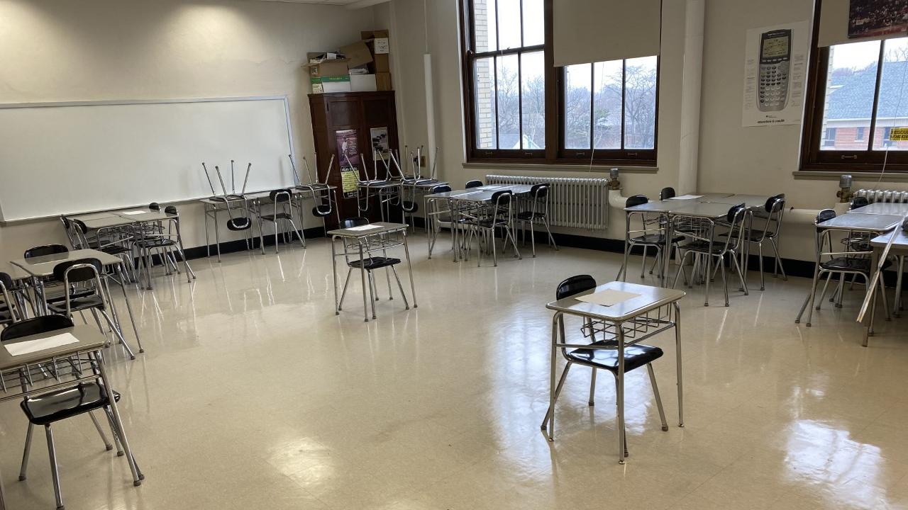
Olmsted Protocols: Classroom Set-Up
SAFETY ZONE
TEACHER AREA

Slide 21
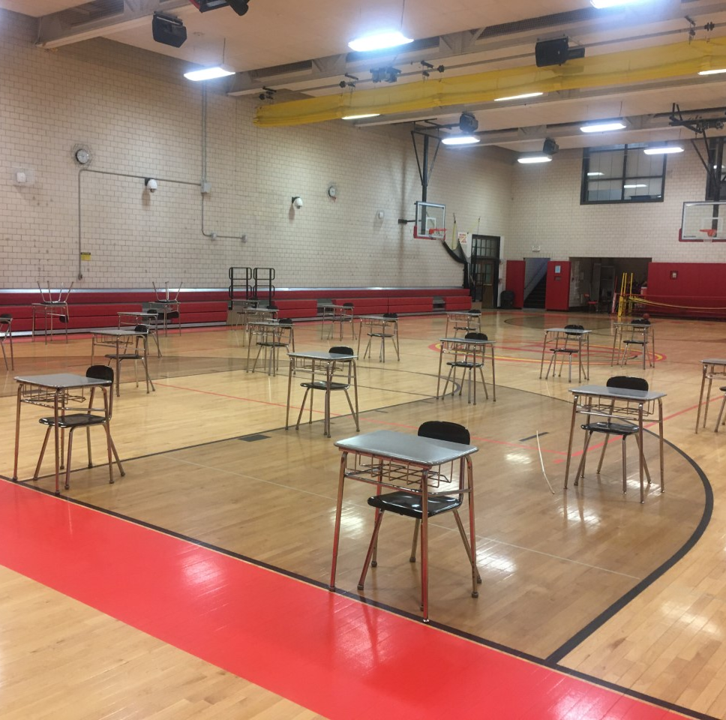
Instructional Modifications
Curriculum & Instruction in Physical Education and Music will remain as is, virtual.
Students participating in in-person instruction art classes CANNOT share materials. Adjustments will be made.

Slide 22
Olmsted Protocols: Instructional Modes
IN-PERSON
Student is in the classroom with their teacher and other students
IN-PERSON REMOTE
Students is in the classroom with other students and adult supervision due to social distancing protocols and room capacity.
REMOTE (VIRTUAL)
Student is learning from home (opt-out)

Slide 23
Olmsted Protocols: Instructional Modes
IN-PERSON
REMOTE & IN-person remote
Social distancing protocols must be followed
Students will follow all teacher directives and continue with synchronous/asynchronous schedule to stay at pace with remote learners
SYNCHRONOUS: whole-group sessions
ASYNCHRONOUS: independent assignments, one-on-one assistance, small groups (socially-distanced)
Students will continue to follow synchronous/asynchronous schedule
SYNCHRONOUS: whole-group instruction with the teacher and students in the classroom
ASYNCHRONOUS: students must check-in with the teacher, attend one-on-one sessions, or small groups, as assigned to work on independent tasks
All students will continue to follow their daily schedule per Infinite Campus.
Some classrooms may change for in-person learners based on social distancing protocols and max capacity/room.
Every effort will be made to keep all instructors the same.

Slide 24
Next Steps
parents
bps
We need to know your intentions:
FLO Re-Opening Intent Survey
Senior parents, please let us know if your child will be returning February 1st.
All other parents, we also need to know whether your child will be returning in the next phase-in waves.
If your child will not be returning, in addition to our survey, please submit the BPS survey:
BPS Opt-Out of In-Person Instruction Survey
If your child is returning, but you do not need transportation services, be sure to opt-out of transportation:
BPS Transportation Opt-Out
The BOE will decide on Re-Opening next Wednesday... Stay tuned!

Slide 25
Questions & Answers
Please submit additional questions and concerns via the Olmsted Survey, the link is on the previous slide.
Q/A will be posted to the school website: www.olmstedatkensington.com

