Slide 1
My brother's keeper (mbk) program has opened registration for fall 2024
Mr. Crump will serve as the MBK Facilitator for Frederick Law Olmsted School #156. Mr. Crump’s classroom is 218.

Slide 2
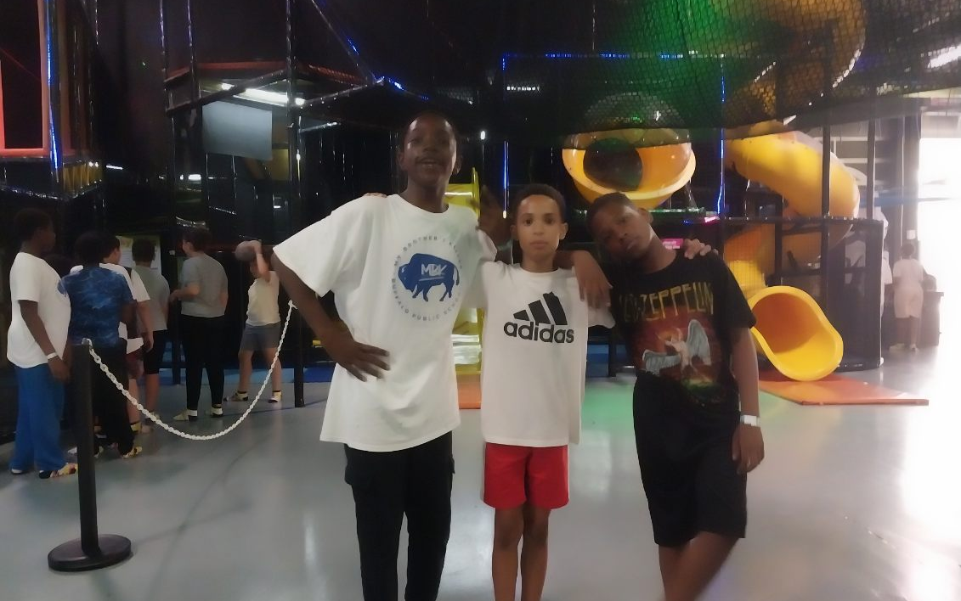
THE MBK PROGRAM PROVIDES, PEER CONNNECTIONS, MENTORSHIP, CULTURAL LESSONS, AND FUN ACTIVITIES.
ALL SERVICES ARE PROVIDED BY BUFFALO PUBLIC SCHOOLS (BPS) AND ARE ALWAYS FREE .

Slide 3
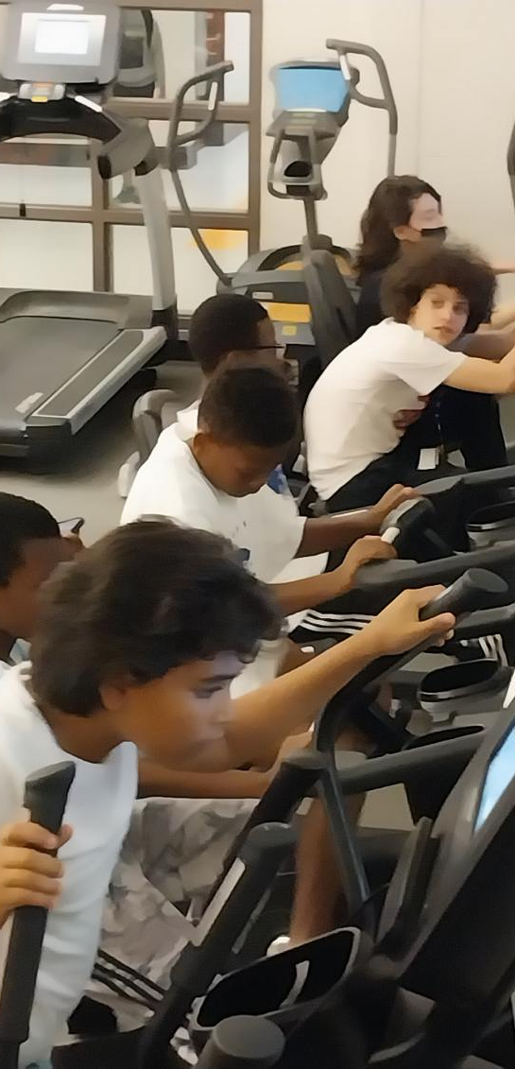
THE 2024-2025 MBK PROGRAM WILL BEGIN AFTERSCHOOL Sessions IN OCTOBER AND END IN MARCH.
THE PROGRAM IS LOCATED AT MCKINLEY HIGH SCHOOL. THERE OUR SATURDAY SESSIONS INCLUDE EDUCATION LESSONS AND RECREATIONAL ACTIVITIES .

Slide 4
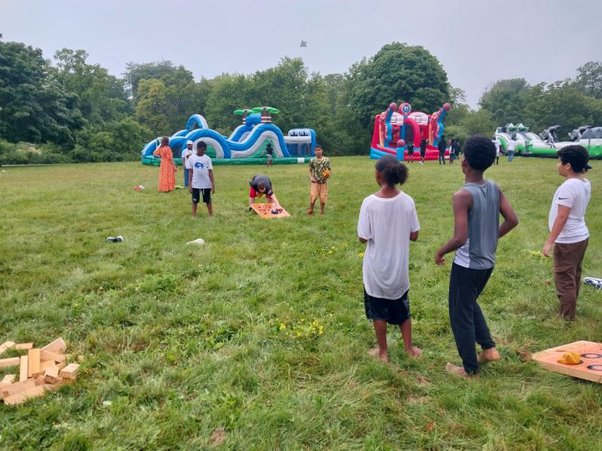
THE MBK PROGRAM WILL MEET AT fl OLMSTED IN ROOM 218 Tuesdays and Thursdays from 3-5pm
All MBK Scholars should meet in the cafeteria and enjoy afternoon snacks.

Slide 5
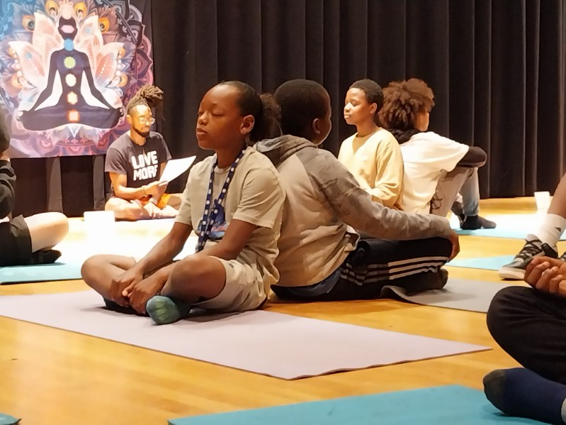
Each meeting provides mbk scholars WITH cultural lessons.
Activities and lessons are also provided for Social and Emotional Learning (SEL).

Slide 6
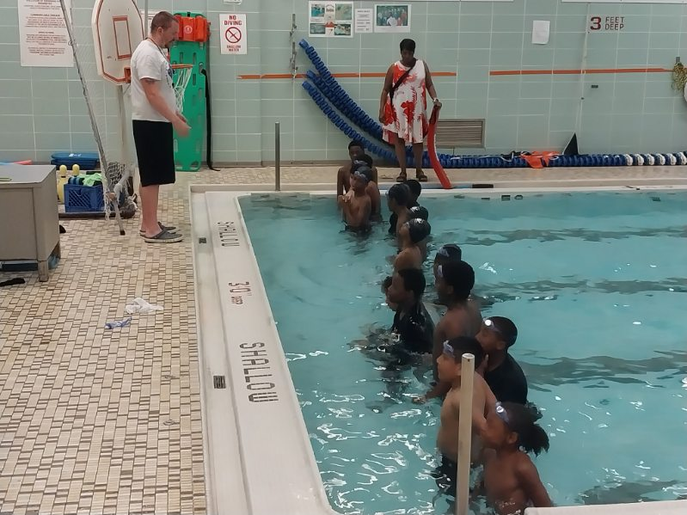
THE MBK PROGRAM PROVIDES scholars with life saving lessons and field trips to historic locations.
ALL SERVICES ARE PROVIDED TO REDUCE DISCIPLINARY REFERRALS AND INCREASE ACADEMIC ACHIEVEMENT.

Slide 7
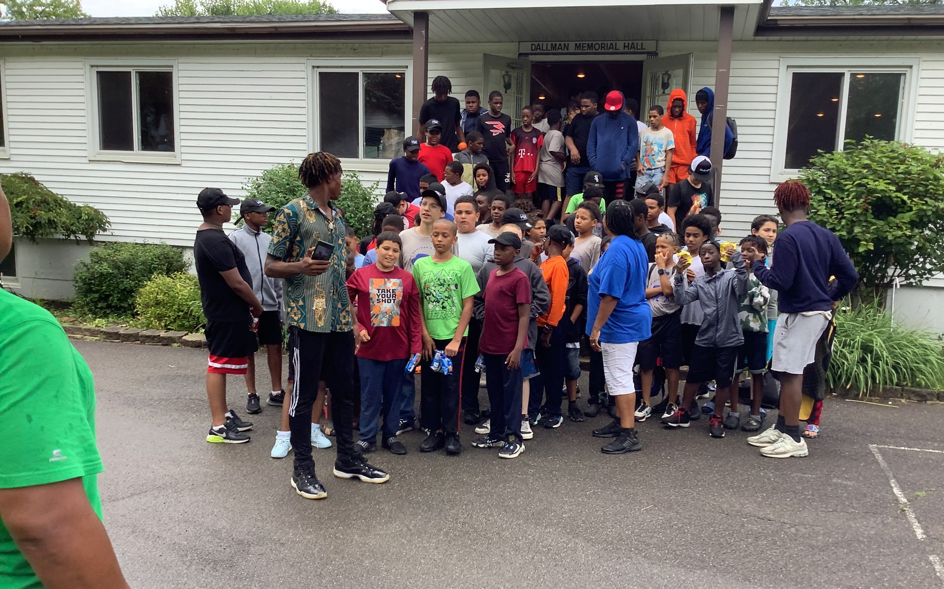
In mbk OUR bps YOUTH are exposed to dream building events and opportunities.
ALL FIELD TRIPS AND ACTIVITIES ARE STRICTLY MONITORED FOR CHILD SAFETY. ALL MBK SCHOLARS MUST HAVE SIGNED CONSENT TO ATTEND SHORT- AND LONG-TERM TRIPS.

Slide 8
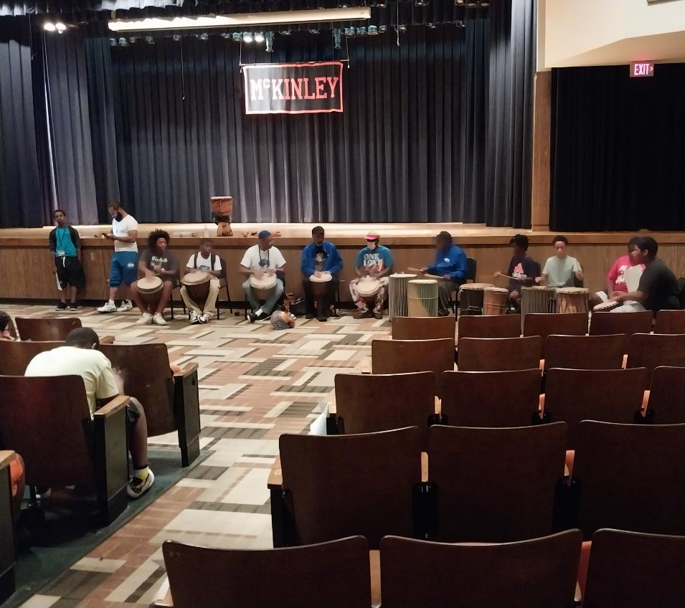
THE mbk PROGRAM OFFERS Youth CONNECTIONS TO COMMUNITY ARTISTS, MOTIVATIONAL SPEAKERs, AND dynamic LEADERS.
MBK STUDENTS CAN LOOK FORWARD TO EXCHANGES WITH DEDICATED PROFESSIONALS WHO ARE PASSIONATE ABOUT THE GOALS OF THE PROGRAM.

Slide 9
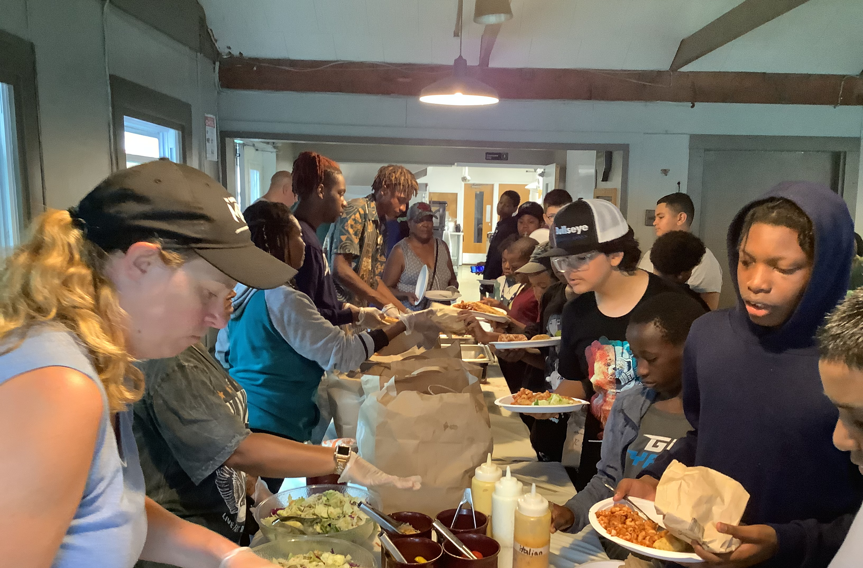
THE mbk PROGRAM OFFERS HEALTHY AND HEARTY MEALS FOR SCHOLARS.
MBK STUDENTS ENJOY AN ANNUAL CELEBRATION WHERE AWARDS ARE GRANTED FOR TOP BPS SCHOLARS. PARENTS AND GUARDIANS ARE ALWAYS INVITED.

Slide 10
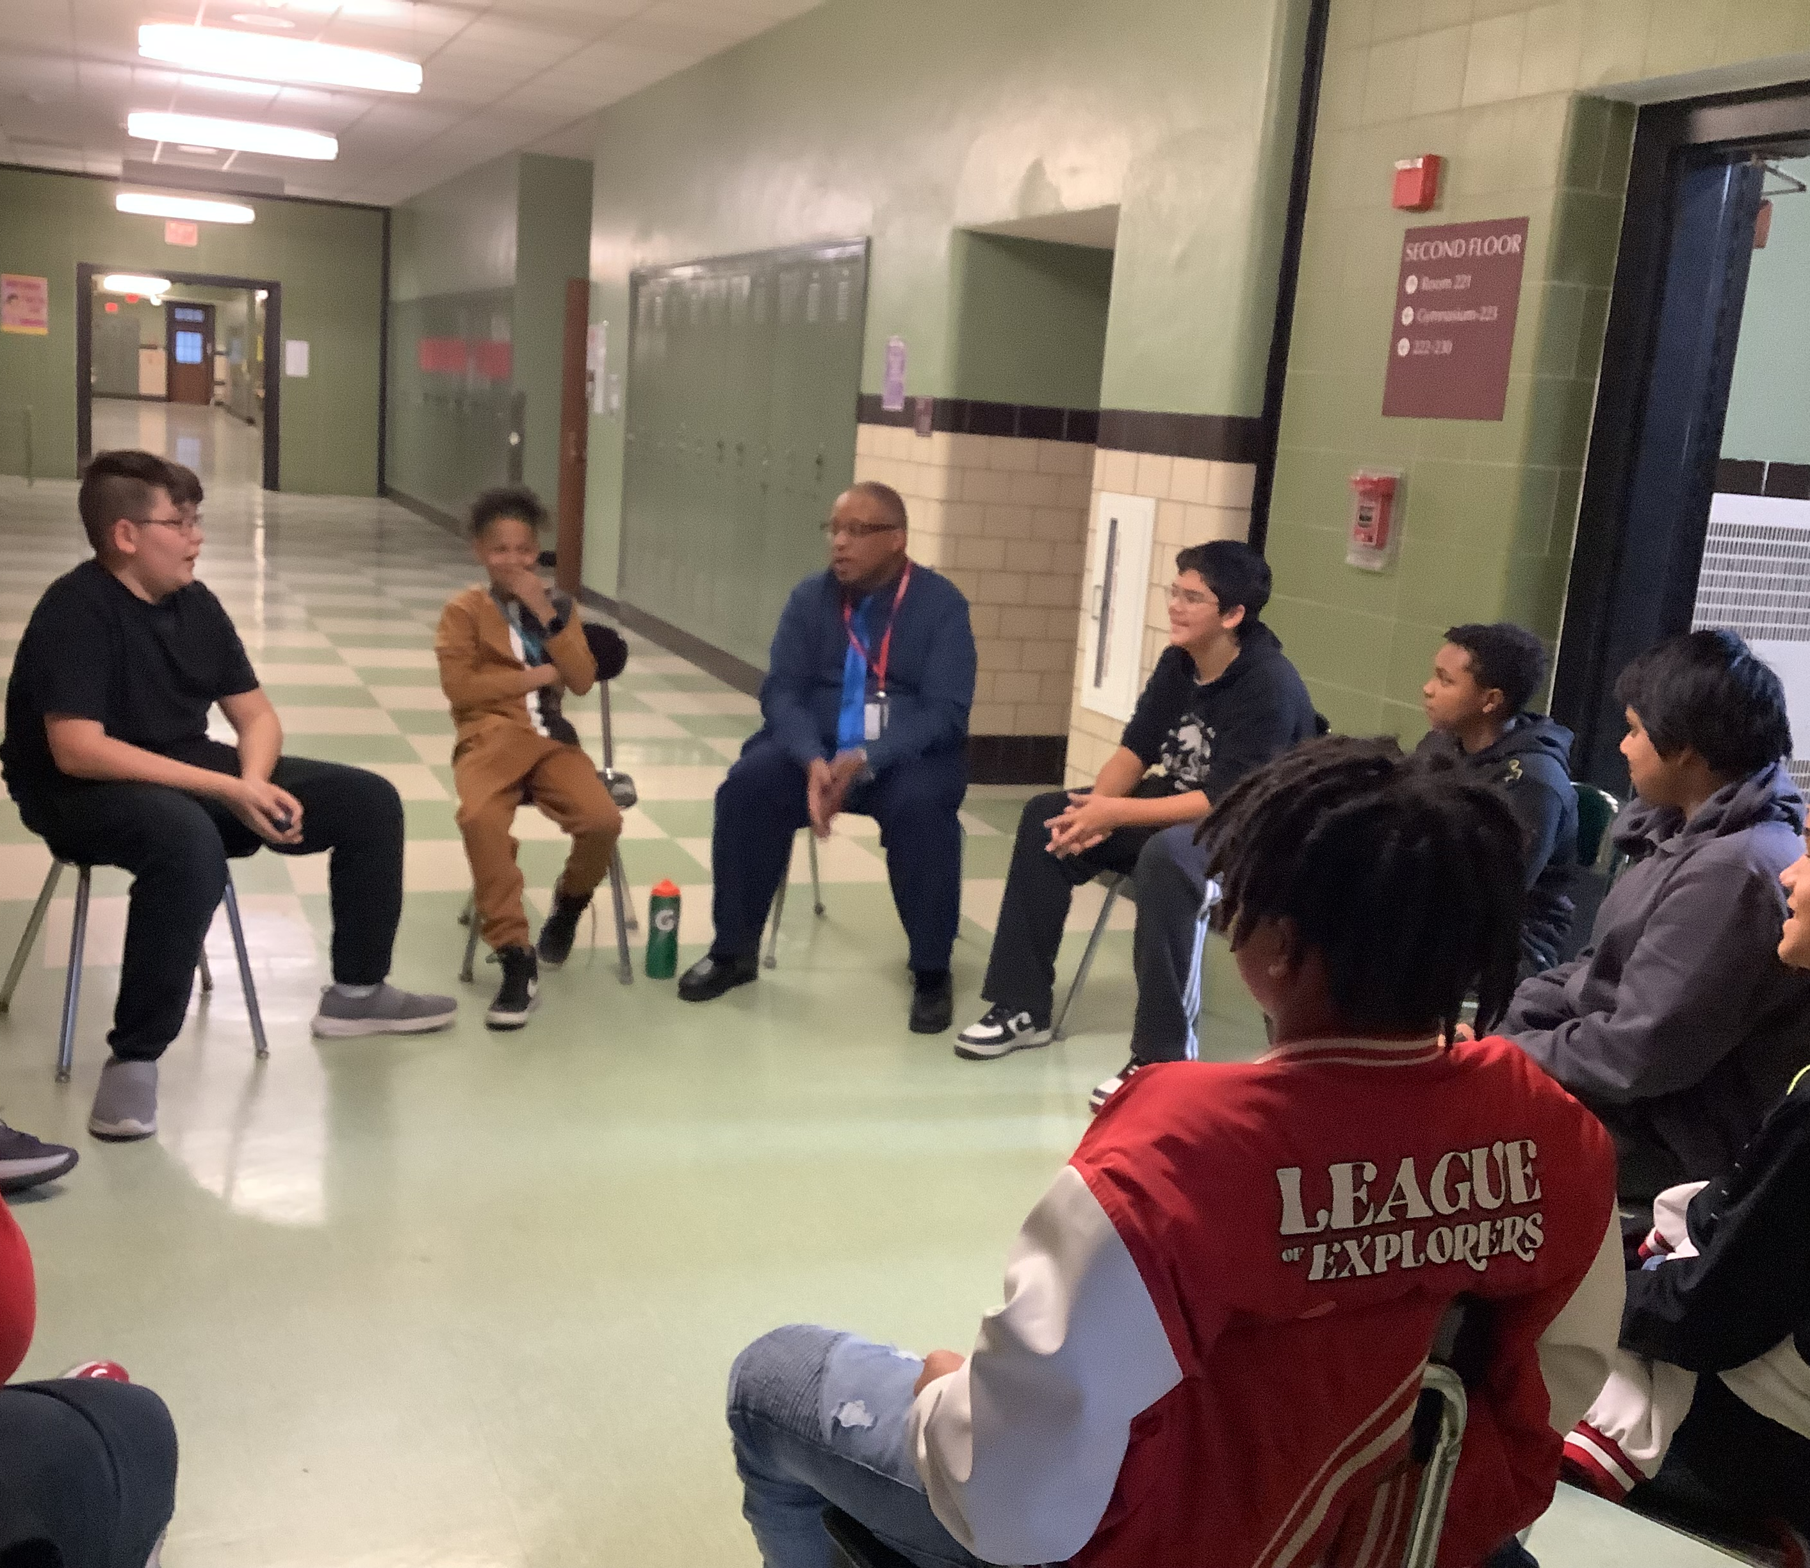
FOR MORE INFORMATION ON MBK AT F.L. OLMSTED 2024-2025 PLEASE CONTACT MR. CRUMP
PLEASE SEE MR. CRUMP IN ROOM 218
EMAIL: GCRUMP@BUFFALOSCHOOLS.ORG
CONTACT ADDRESS AND NO.: 319 SUFFOLK STREET, BUFFALO, NY 14215
716-816-4330 x1218

